Slide 1
Group by module 6
Note to other teachers and users of these slides. Feel free to use or modify these slides as you wish. If you use a significant portion of these slides in your own lecture, please include this message, or the following link to the source repository of Michele’s lectures on github:
https://github.com/samorani. Comments and corrections are welcome.

Slide 2
Group by
Goal: compute aggregate measures by categories
Examples:
For each program, count the students with a full-time job
For each job situation, compute the proportion of students who know Java

Slide 3
Today’s data set
cleaned_survey.csv

Slide 4
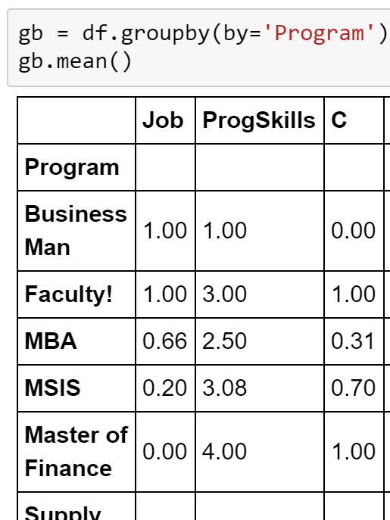
Df.groupby(by=column)
groupby returns a DataFrameGroupBy object
This object has various aggregating methods, like mean, min, max, etc
An aggregating method returns a DataFrame
Whose index is the column we grouped by, and
Whose columns report the aggregate value within
the group
The average of ‘C’ among MBAs is 0.31

Slide 5
Most common aggregate functions
count: number of non-null values
size: number of values including nulls
mean: mean of non-null values
min: min among non-null values
max: max among non-null values
sum: sum of non-null values

Slide 6

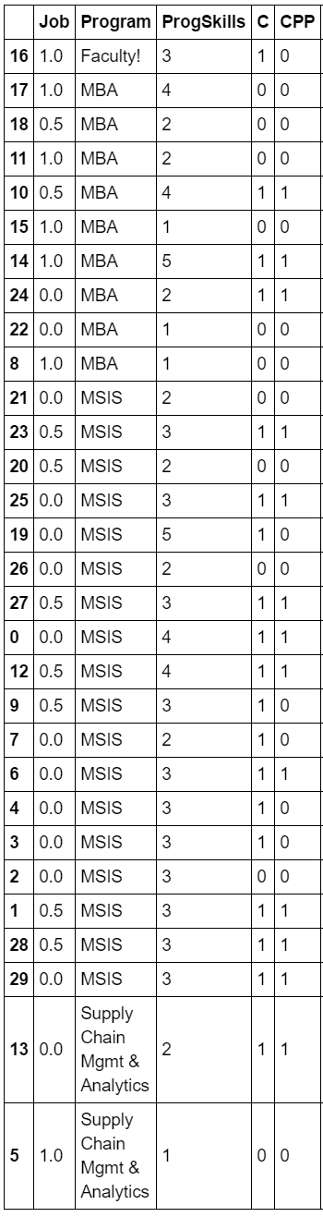
Group by in slow motion – step 1: SPLIT
STEP 1: Split by program. This operation does not compute anything (very fast)
We can think of these partitions as DataFrames (will be useful later)

Slide 7


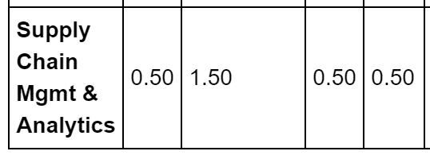

Group by in slow motion – step 2: APPLY
STEP 2: Apply the aggregating function to each group (slow)

Slide 8
Group by in slow motion – step 3: COMBINE
STEP 3: Combine into a new DataFrame

Slide 9
Group by in slow motion – step 3: COMBINE
The column(s) indicated in the by argument will become the index (unless you set as_index=False).
In this example, the resulting DataFrame will have one row per Program

Slide 10
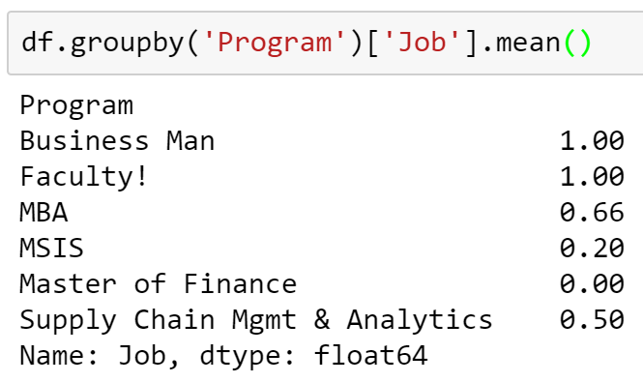
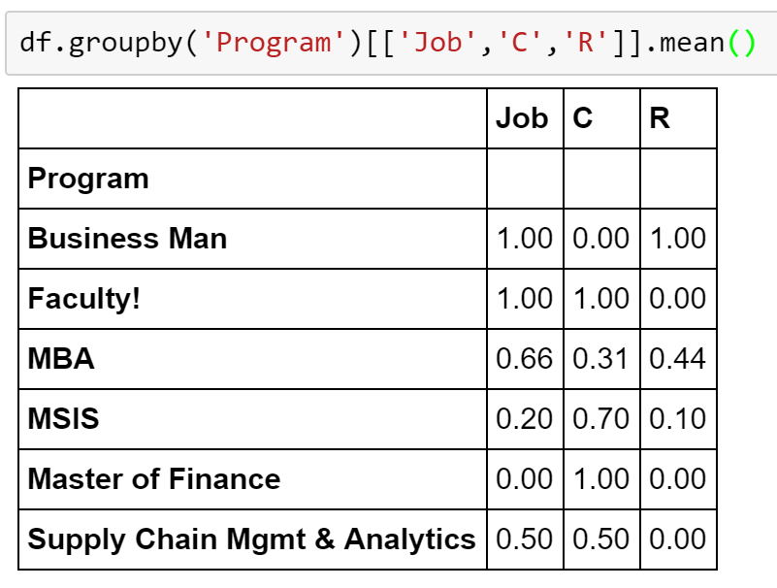
Aggregate only few columns
We want to compute the aggregations among few columns only
On one column:
On three columns:

Slide 11
Problems
For each Job situation (0=no job, 0.5=part time, 1=full time), find the proportion of students that know SQL
For each program, count how many student know SQL.
Considering only the students who know SQL, find for each Program the proportion of students who know Java
Which one is faster? Why?
df.groupby(by='Program')['SQL'].mean()
df.groupby(by='Program').mean()['SQL']
(HARD) For each Classification skill level, how many MBA students are there? Your result should have 5 rows (one for each classification skill level: 1, 2, 3, 4, and 5)

Slide 12
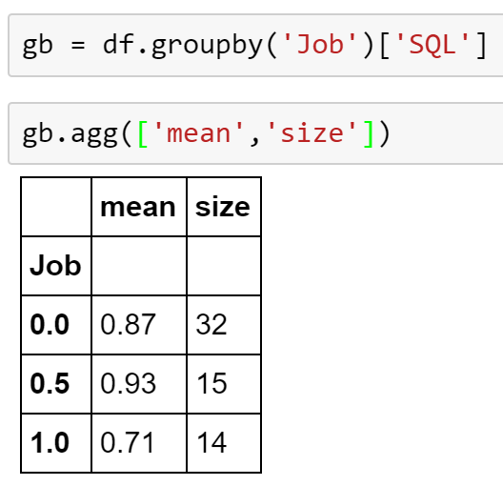
Apply multiple functions to one column (agg)
Oftentimes, we want to apply more than one aggregating function during the same group by operation
For example:
For each Job situation (0=no job, 0.5=part time, 1=full time), find (1) their number and (2) the proportion of students that know SQL.
We can use agg and pass the list of functions

Slide 13
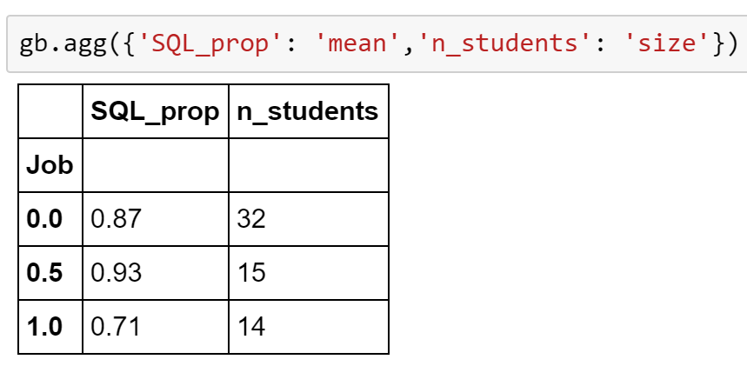
Apply multiple functions to one column (agg) – rename columns
When using agg, you can rename the column names in the resulting data frame
For example:
For each Job situation (0=no job, 0.5=part time, 1=full time), find (1) their number (call it n_students) and (2) the proportion of students that know SQL (call it SQL_prop).
You need to pass a dictionary of {new_column_name : function_name}
Create:
a column SQL_prop computed by applying the function “mean”
a column n_student computed by applying the function “size”

Slide 14
Apply multiple arbitrary functions to multiple columns (agg)
Oftentimes, we want to apply different aggregating functions to different columns
For example:
For each Job situation (0=no job, 0.5=part time, 1=full time), compute the average knowledge of SQL, the maximum knowledge of Classification, and the gap between the mean and the max Classification

Slide 15
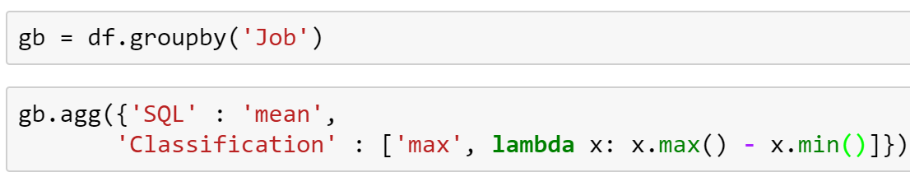
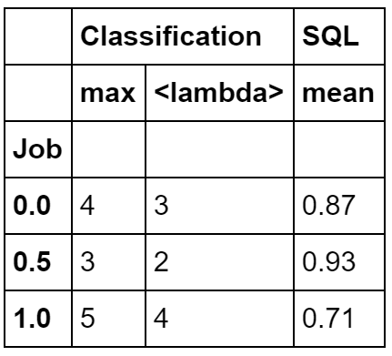
Apply multiple arbitrary functions to multiple columns (agg)
This function will be called once for each value of Job. Here, x is the array of values of Classification for the current Job value
We can use agg and pass a nested dictionary
For each Job: Compute the mean SQL
For each job, summarize the column Classification by:
Using the function max, and
Using the anonymous function that we passed
(compute the difference between max and min Classification for the current Job)
The classification spread among those with Job=0.5 is equal to 2

Slide 16
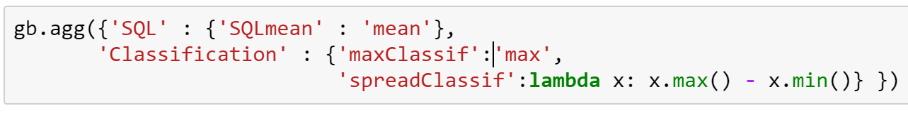
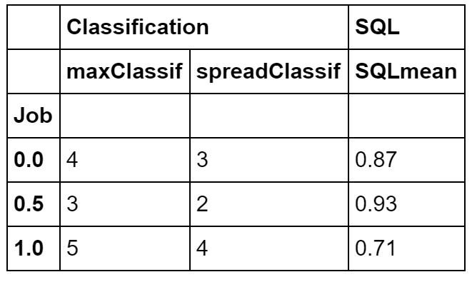
Apply multiple arbitrary functions to multiple columns and give them names (agg)

Slide 17
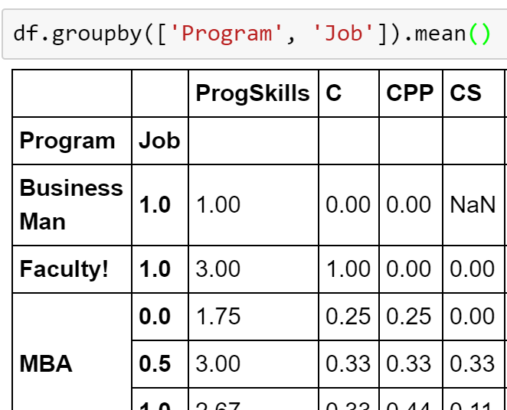
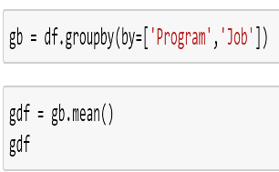
Group by multiple fields
Sometimes, we want to group by unique combinations of values in multiple fields
For example: find the mean of all columns grouped by Program and Job situation. That is, we want one row for each combination of (Program, Job)
Hierarchical index! (Or MultiIndex)

Slide 18
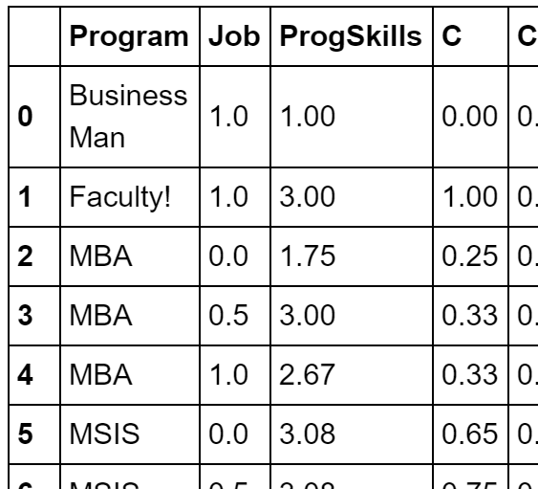
Hierarchical Indices (and how to avoid them)
A row identifier that is composed of two or more fields
The same as “composite key” in relational databases
It is quite complex to deal with them in pandas
Avoid them using as_index=False

Slide 19
Problems
Find the maximum, minimum, and average number of Languages known by students in each Program
For each existing combination of programming skills level and Program, report the number of students (call it nStudents) and the proportion that know Python (call it PythonProportion)
HARD. For each Program, report:
the number of students who know both Python and C (call it C_Python_Students, and note that it can be equal to 0)
the gap between max and mean Clustering knowledge (call it CluGap)

Slide 20
Retrieve unaggregated rows (apply)
Sometimes, for each group-by value we want to retrieve one or more rows.
For example, for each program report the student who knows most languages (report more than one students in case of ties)
To do that, we need to define a new logic for the apply phase.
Input: A DataFrame relative to one partition
Output: A DataFrame with the rows that we want to output
In the example above:
Input: A data frame of the students belonging to one program (because the group by is done by Program)
Output: The subset of students with the largest value in Languages

Slide 21
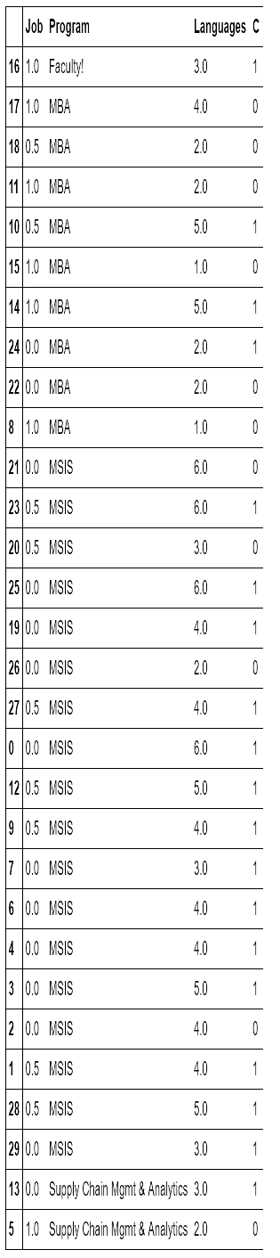
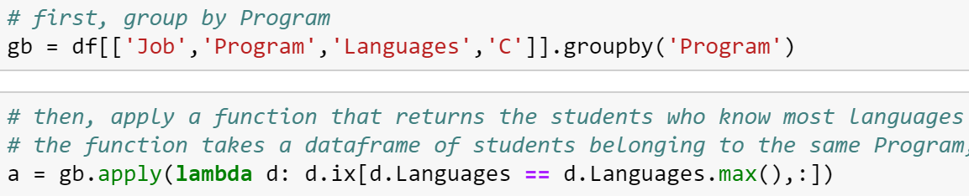
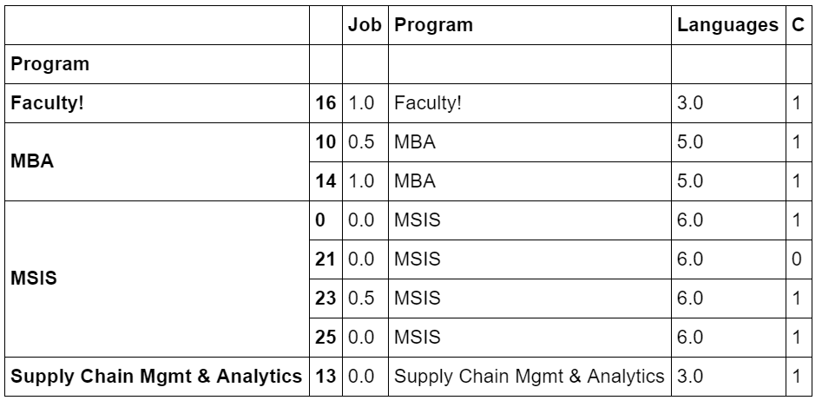
GOAL: For each program report the student who knows most languages (report more than one students in case of ties)
DF of Faculty
These 4 dataframes will be passed as input to this function
DF of MBA
Which selects the students who know most languages within their group
DF of MSIS
DESIRED RESULT
In YELLOW: Students with the largest number of languages within their group
DF of Supply Chain

Slide 23
Problems
For each ProgSkills level, find whether the student (or students in case of ties) with the highest Classification skills know C and Java
For each ProgSkills level, find the Program with most students that have that ProgSkill level

